Slide 1
Testing a Shopping Web Backend APP
https://github.com/rene-kt/spring-restapi-ecommerce
Kecheng An Yike Zhang Zeyuan Pu
April 24th 2023
Notes:
Welcome everyone to the presentation of the Spring REST API E-commerce testing project. My name is …

Slide 2
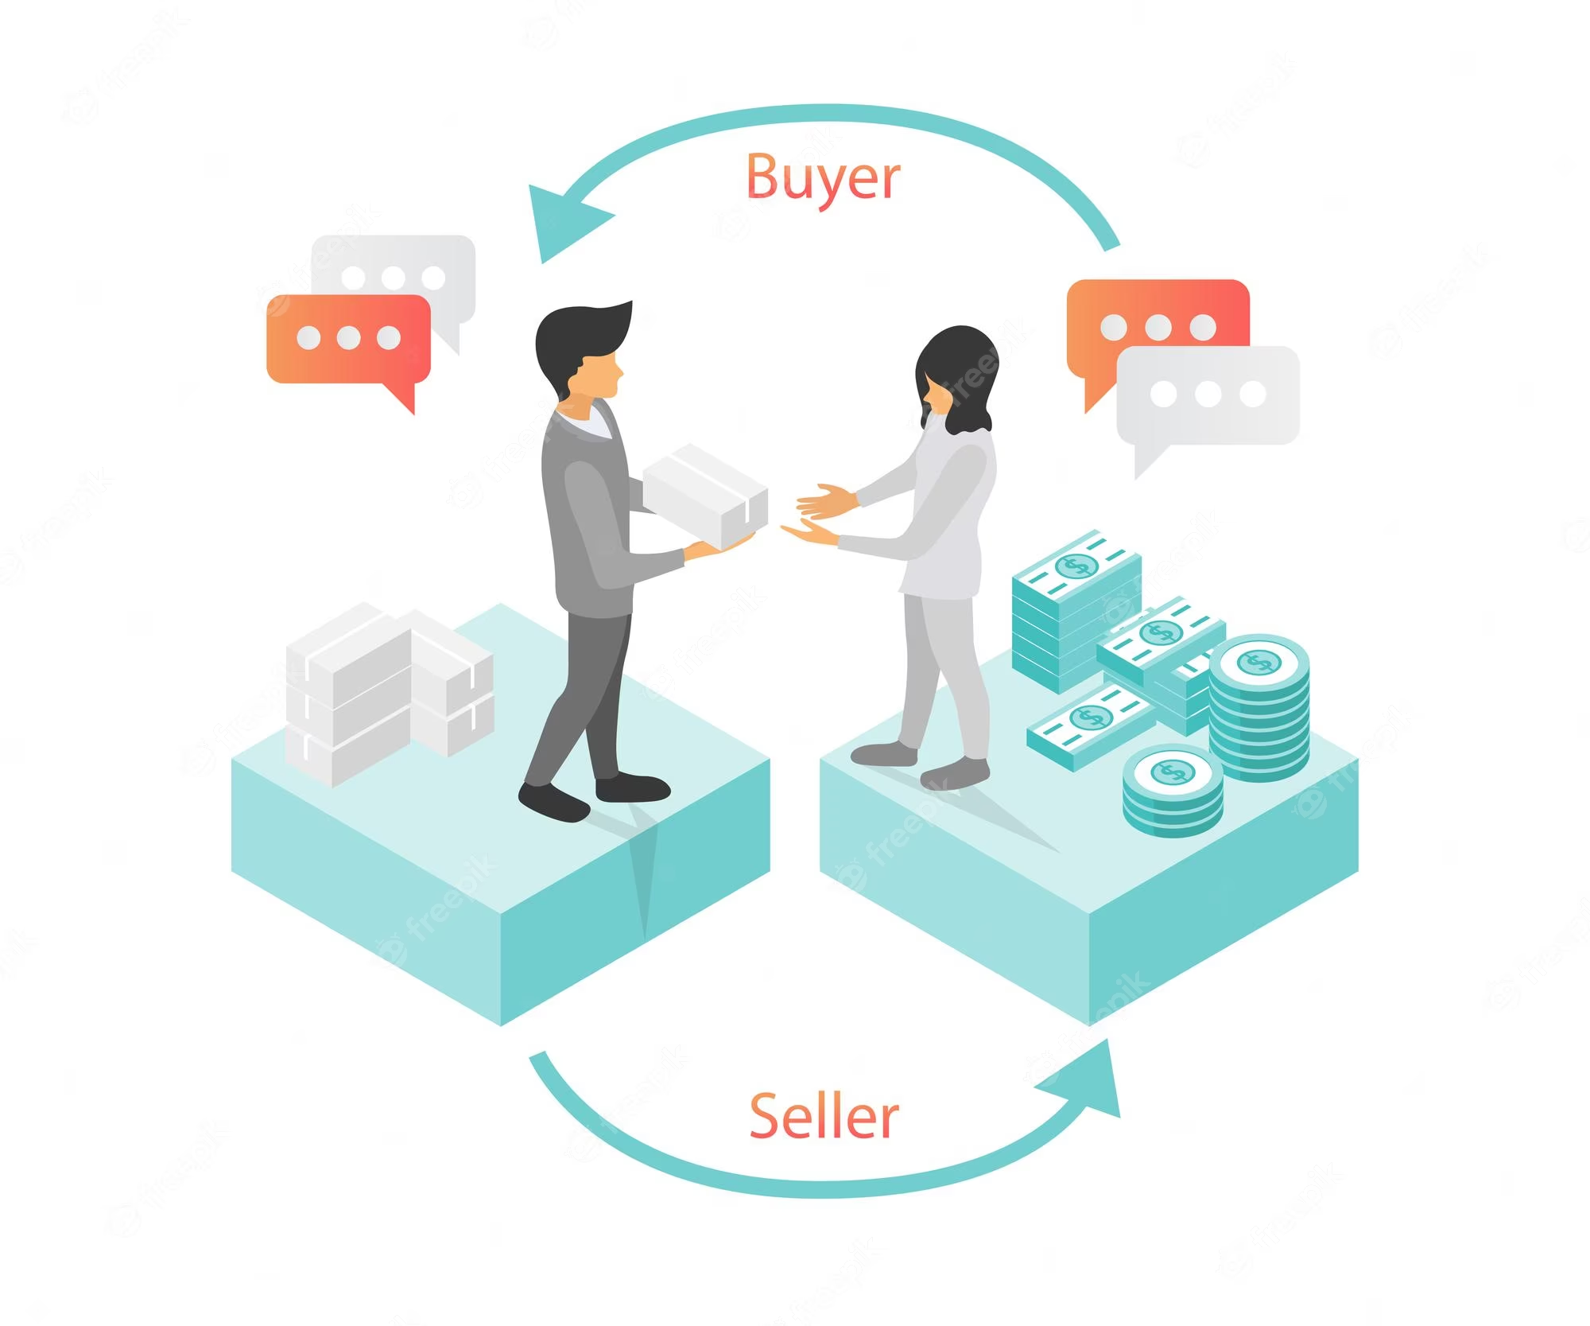
E-Commerce App
Background
Cross-platform backend software for ecommerce website or apps.
Potential User:
Buyer and seller for any shopping
website
Notes:
This project is a cross platform backend software that supports both website and mobile apps.
Potential users are buyer and seller for any kind of shopping website.

Slide 3










E-Commerce App
Technology
Java
Spring boot
Spring Data JPA
Spring security
JWT
SMTP Email service
Postman
Swagger
PostgreSQL on AWS
Maven
3679 lines of java code
Notes:
This project is a backend software based on java springboot. There are couple of tech and framework it uses. Such as: …..
We found this open source project on github and it has 40 stars and 28 forks. And it has 3679 lines of java code.

Slide 4
E-Commerce App
Features
User can
Sign up and Sign in
Update and Delete profile
Get a seller and client ranking
Reset password
Notes:
Features of the project is simple and intuitive.
There are 2 kinds of users of the project, client and seller.
Both user can register and login, update their profile and get a ranking of the client or seller, which is like who is the best seller or who is the client that purchase most of the product.

Slide 5
E-Commerce App
Features
Client
View products
Add to wishlist
Buy products
View order info
Seller
Post/Update/Delete products
Sell products
Receive notification through email if clients request purchase
Notes:
Client can …
Seller can…

Slide 6



E-Commerce App
Test Tools
Junit5
Mockito
Rest-assured
Coverage criteria:
We aim to achieve branch coverage as high as possible
Notes:
We will showcase the various tools and frameworks that we have used for testing, such as JUnit, Mockito, and rest-assure.
So let’s first look at the API testing which is treated as the black box testing of the project.

Slide 7
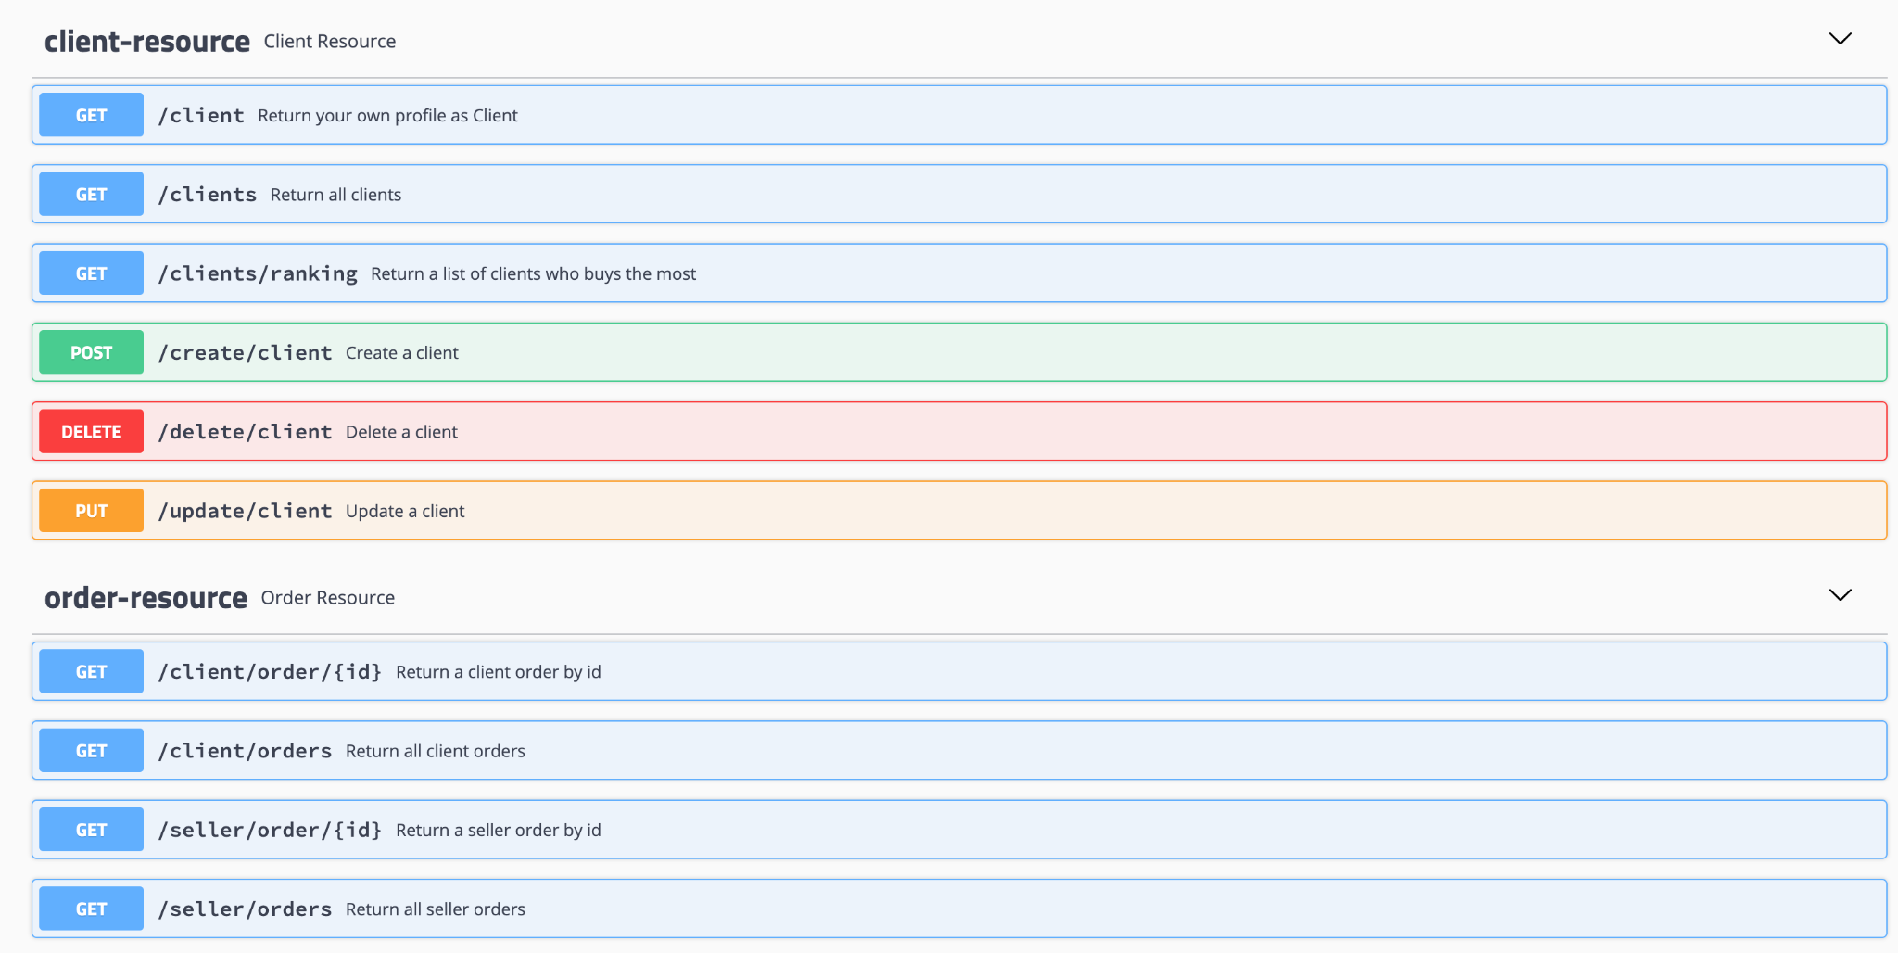
Blackbox & Rest API Testing
Swagger-UI
Rest-assured
Postman
Notes:
Even though this a pure backend project without any user interface, we can config a tool called swagger-ui to automatically generate the api document for us.
—Demo—

Slide 8
Rest API Testing
DEMO

Slide 9
Failures
POST /product: create a new product with a negative price, succeed, but shouldn’t be allowed
Invalid ID related:
GET /client/order/:id : return a client order with invalid id, should return 404 not found, but returns 500 server error
GET /seller/order/:id : return a seller order with invalid id, should return 404 not found, but returns 500 server error

Slide 10
Failures
Authorization related: should return 403 forbidden, but actually 500 server error
POST /product: create a new product with a client’s authorization token
GET /ownproducts: get all products of a seller with a client’s token
PUT /buy/:id: buy a product as a seller
GET /seller/order/:id : return a seller order by id, with client token
GET /client/order/:id : return a client order by id, with seller token
GET /wishlist : return a client's wishlist, with seller token

Slide 11
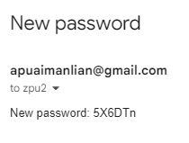
Improper design
POST /forgot: send a new password to user’s email
Functionally correct.
But not practical at all.
Other user can reset my password
Can’t choose my own new password
What if I don’t have access to my email

Slide 12

White Box Testing
Methodology
Use mock testing to simulate
database interaction
mail service
Password encryption and decryption
Notes:
We heavily used mock testing in our whitebox test cases. This application has multiple external services like databases and smtp service. Which is extremely highly coupling.
For example, during the testing process, we don’t want to change the data in our database or actually send an email to the user.
Using mockito can break down the services that depend on each other and let us focus on the business logic itself.

Slide 13
White Box Testing
DEMO

Slide 14
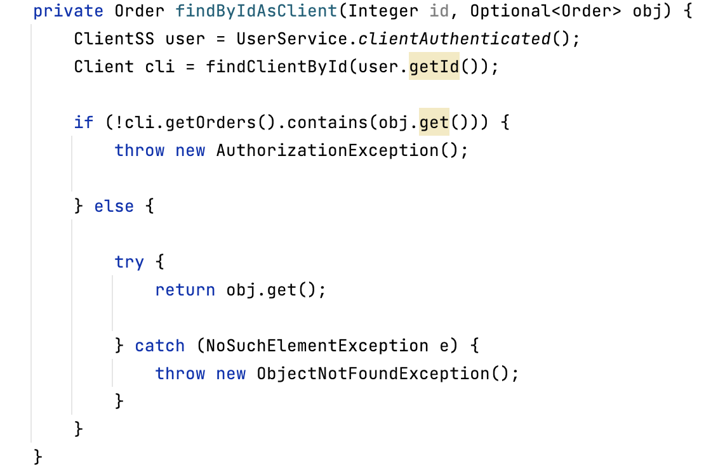
Fault Example
Method Input Checking
Should check obj.isPresent()
before using obj
Order Information API
Notes:
So I would like to demonstrate some fault we find during Unit Testing.
So first kind is no input checking.
We have an API for serving Order information, it takes the Order ID as the input and return the order information.
So this API will first query the database with this order ID, and call this helper function for further processing.
Sometimes we cannot find the order in the database, then this order object becomes empty.
This method directly call this object's method without checking if this object is empty or not, leading to a 500 error. We also found this error during blackbox testing.
To fix it, we need to check if an order is found before using it by including an isPresent method.

Slide 15
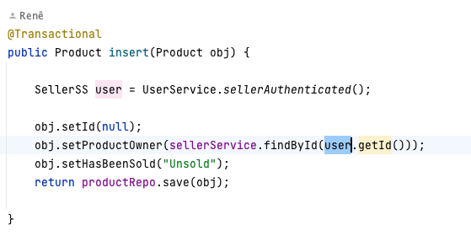
Fault Example
Authorizing the Correct User Type
Should check if a correct user type is authorized
If no authorized Seller object is obtained, throw error and terminate the function.
Product Create API
- Seller Input Product information
- Failure: send a buyer-token request
Notes:
The second fault is authentication issue.
This service is for seller to create a product. So the method will take the Product information as the input.
It will read the authenticated seller object based on the token in the HTTP request, set the product owner as this seller, and save it to the database
However, if we send the HTTP request using a buyer’s token, it will go through the authentication check. But this method want to get a seller's object. So the server throw nullPointException and lead to an HTTP 500 error. It should throw a 403 forbidden error.
To fix it, we should include a try catch check when attempting to read an authentication Object. It might not be the Seller type we want. If it’s not, we should return immediately.

Slide 16
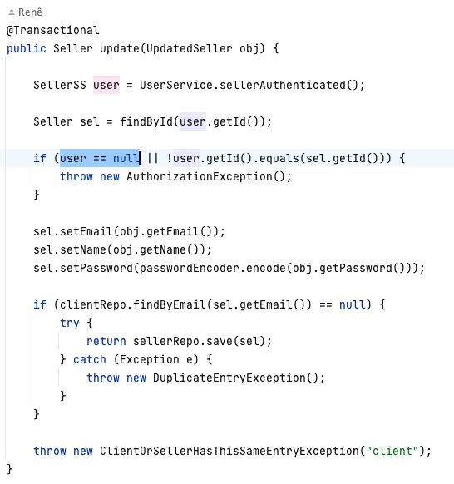
Bad Practice Found
Unused Authentication Check
authentication check appear after the auth object is called
Auth object is called
Auth check
NullPointException throw by Java
Seller Information Update API
Notes:
We also found some bad practice during Unit testing. We cannot say it’s a bug because it won’t trigger from the client side. But this problem will appear in Unit Testing.
Take this API as an example for Updating seller information. Ideally you want to make sure that the user need to log in first before they are allowed to send request for updating their info.
This methods still included an authentication check. But the check is done after the authentication object is called. So when there is no valid authentication, it will leads to nullpointexception, instead of AuthorizationException defined by the author. We found this issue in our unit testing and not in the API testing.
The author enforce that only a limited amount of APIs are public, so this API is only accessible after logging in.

Slide 17
Bad Practice Found
No Input Sanitization / Checking
Inconsistent authentication checking
Poor documentation
Notes:
Here is other bad practices:
first is that there is no input checking. The author assumes that the input will be sanitized or checked at the frontend. But that's not enough because users may bypass the frontend and directly use API to interact.
We also find that some API contains authorization check and some does not. So sometimes it relies on the Springboot authentication, sometimes it does not. So it have issues like without checking the authenticated user is correct type.
Lastly is poor documentation. The code does not contain any inline documentation. We reached out to the project author to understand how to get a API documentation so we can perform blackbox testing.

Slide 18
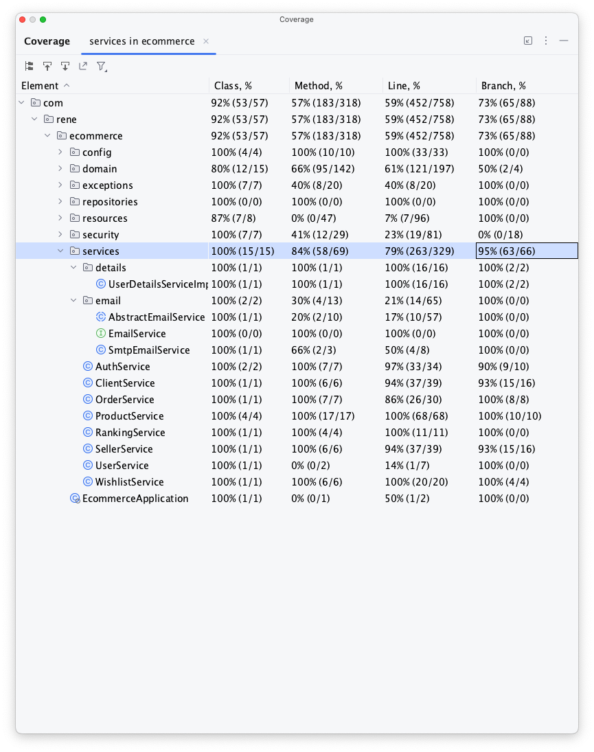
Current Progress
Tested all available Restful APIs
Achieved Branch Coverage
Services (Business Logic): 95%
Whole Project: 73%
Does not cover code related to Database connection, email services

Slide 19
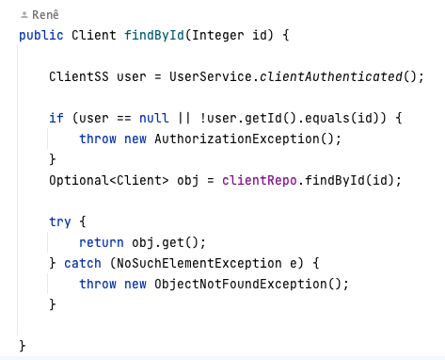
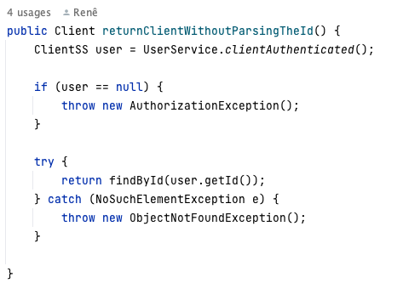
Some Branches Are Impossible to Reach
Example: Duplicate error catching
Find Client Info API
Notes:
So our initial goal is to reach high branch coverage. We realize it's not possible to reach 100%.
Here is a example on why. So duplicate

Slide 20
Remaining Work & Takeaways
Achieve higher branch coverage in the whole program
Load Testing
Make a PR for the original repo
Walk through backend construction using spring boot
Set different mockito mode to mock different services
Notes:
Such as smtp services testing to ensure that the correct message is sent to the user.
Perform load testing.
We have contacted to the author and will make an PR after this testing project.

Slide 21
Q & A
Thank you for listening!

